Slide 1
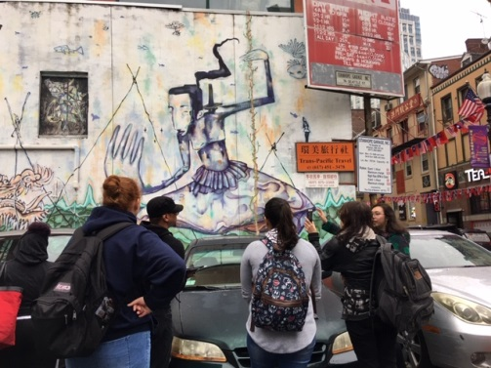
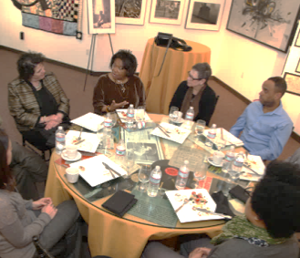
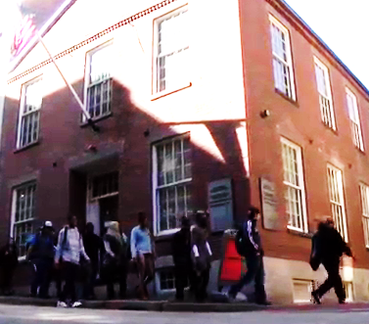

BHCC Center for Equity
& Cultural Wealth
Liya N. Escalera, Dean
Behavioral, Social Sciences & Global Learning

Slide 2

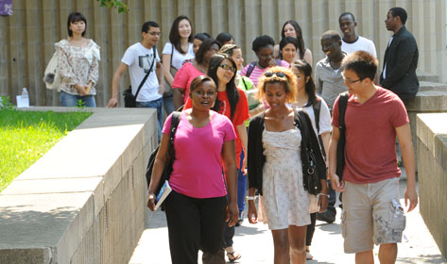
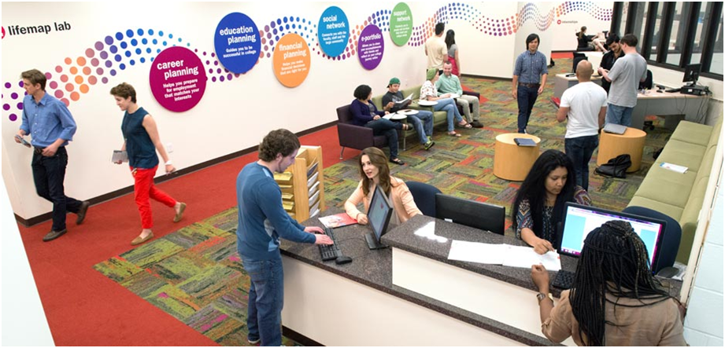
The Problem
(The problem is not our students)
“…we have learned to view inequality in educational outcomes as a problem of student underpreparedness, not a problem of practitioner knowledge, pedagogical approaches, or “culturally held” ideas about minority students… It is far more likely that practitioners will attribute inequality in educational outcomes to student deficiencies than question their own practices.” (Bensimon, 2007, p. 456)
Notes:
Many college learning environments, policies and practices:
Design academic programs for full-time enrollment and linear curricular pathways;
Assume students are dependents who do not work full time, and support families while in college;
Attribute the cost of college to tuition and fees, neglecting the opportunity cost of decreased work hours, and additional expenses of child care and transportation;
Separate curricular and co-curricular learning;
Promote (and reward) a Western Epistemology;
Assess outcomes that are impractical, undesirable and/or irrelevant for community college students.

Slide 3
Equity
& Cultural
Wealth
Accelerated & Aligned Curriculum
Learning Communities
Learning Communities
Student Success
Agenda
LifeMap
& Career Exploration
Early College
& Pathway Programs
Basic
Needs

Slide 4
BHCC Cultural institutes
2012
2014
2016
2018
Gaston & Chelsea HS Partnership, Latinx Student Success Institute PIF Grant
AANAPISI Designation, Grant & LGL Institutes
MAAH Partnership, Freedom Rising Institute & catalyst Fund Grant
UMB Asian American Studies Partnership & NEH Grant
Center for Equity &
Cultural
Wealth

Slide 5
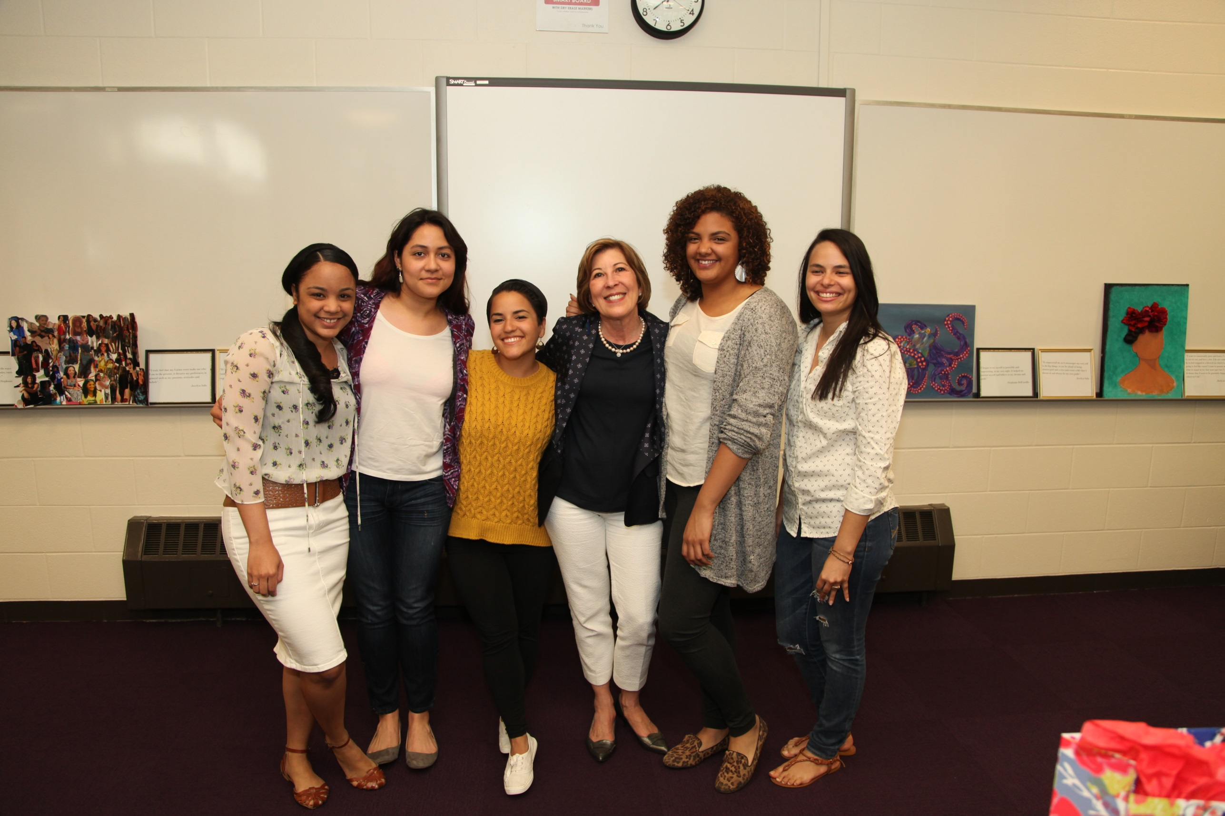
Drawing from our Successful Models
Critical Components
MAAH, NEH, LSSI & AANAPISI LGL Cultural Institutes
National & Local Scholarship & Research
Curricular Development & Integration
Faculty Fellows
Ongoing Professional Development
Storytelling & Student Voices
Community Partnerships
Civic & Service Learning Projects
Educational and Career Planning
Aligned and Accelerated Models
Strengths-Based Approach, Emphasis on Cultural Wealth
LSSI
NEH
Framework for Cultural Wealth
MAAH
AANAPISI

Slide 6
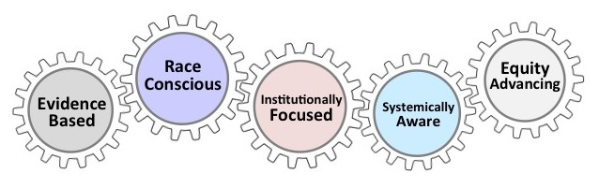
Integrating Scholarship on Equity-minded practice & Cultural Wealth Theory
“Equity-mindedness asks us to turn the mirror on ourselves and accept the fact … that we actually may play a pretty significant role in creating [inequitable outcomes]. So there are barriers that are extant but for many people very difficult to identify, [and] because they seem so normalized, people continue to work with these practices never once considering that these seemingly innocuous practices contribute to inequitable outcomes.”
Notes:
“The term “Equity-Mindedness” refers to the perspective or mode of thinking exhibited by practitioners who call attention to patterns of inequity in student outcomes. These practitioners are willing to take personal and institutional responsibility for the success of their students, and critically reassess their own practices. It also requires that practitioners are race-conscious and aware of the social and historical context of exclusionary practices in American Higher Education.”

Slide 7
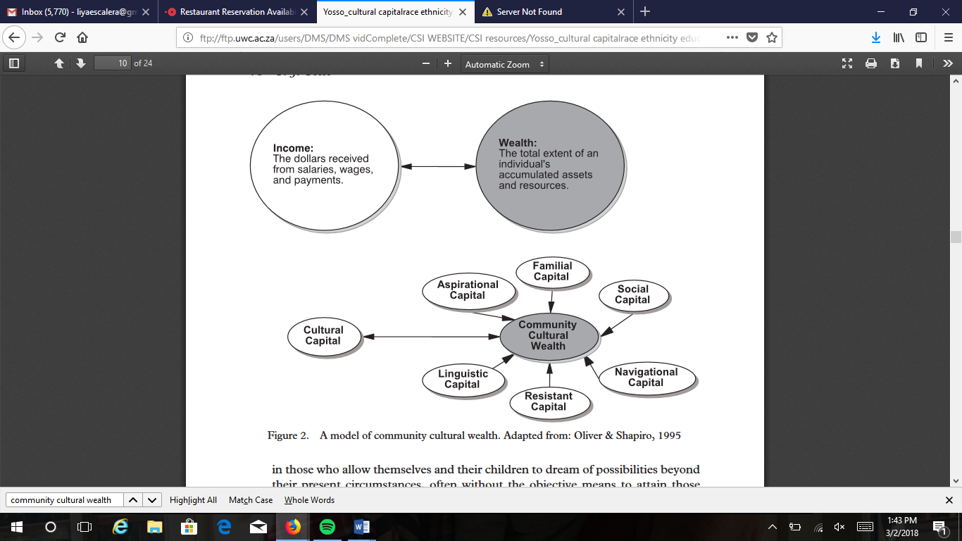
Integrating Scholarship on Equity-minded practice & Community Cultural Wealth Theory
“Community cultural wealth is an array of knowledge, skills, abilities and contacts possessed and utilized by Communities of Color to survive and resist macro and micro-forms of oppression” (Yosso, 2006).
Notes:
“For decades, higher education’s work to support student success has been built on a grand narrative in which underserved and underrepresented students from low-income backgrounds are portrayed as “high risk,” “high maintenance,” “underprepared,” or “culturally deprived” (see, for example, Delgado Bernal 2010; Moll et al. 2001; Yosso 2005). Absent from this deficit-based narrative are asset-based views about the cultural wealth that students employ to transcend their socioeconomic circumstances and to excel in education” (Yosso, 2006).

Slide 8
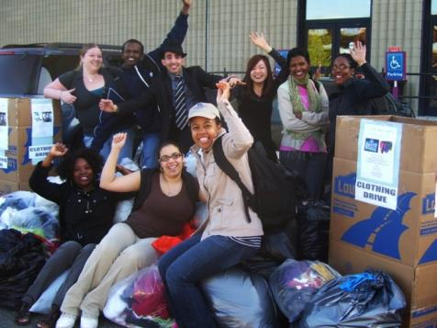
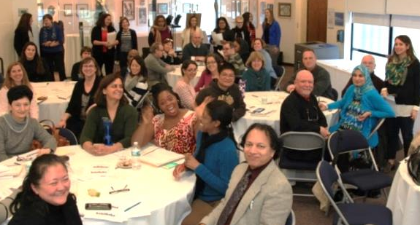
Why is this working?
Assumes that all students are capable of success
Rigorous engagement with local/national research & practice
Focuses on Equity Outcomes: Prioritizes reflection, assessment and continuous, evidence-based improvement (What and how we measure success)
Engages the College in meaningful, scholarly discourse about topics, communities, and issues that reflect who we are and what we care about
Supports faculty and staff development in implementing pedagogical models that we know work for diverse, adult learners

Slide 9
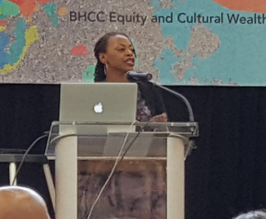
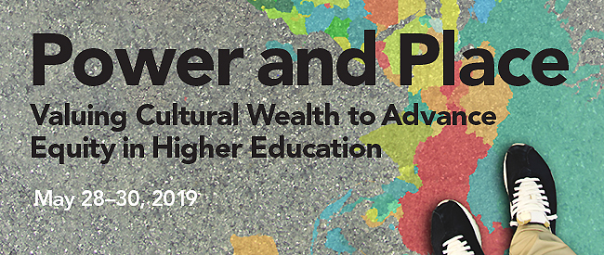
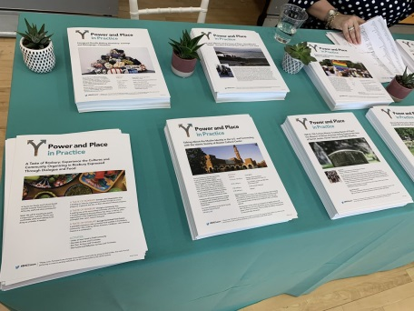
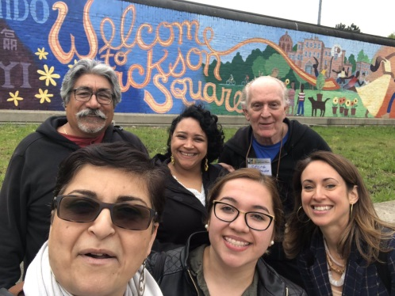
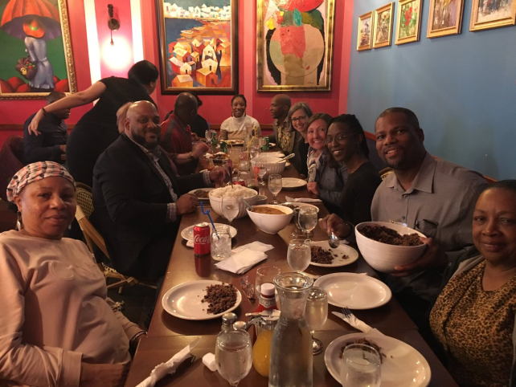
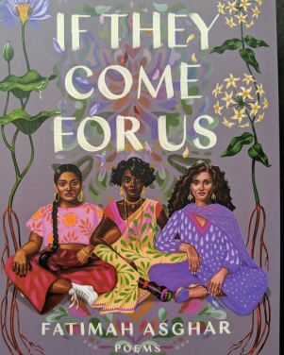
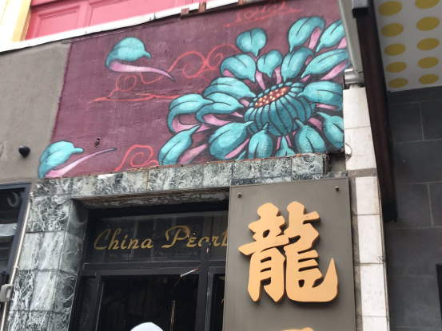
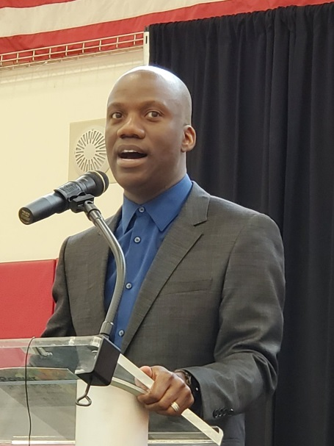
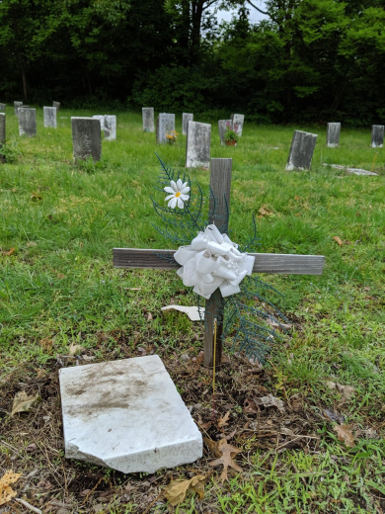
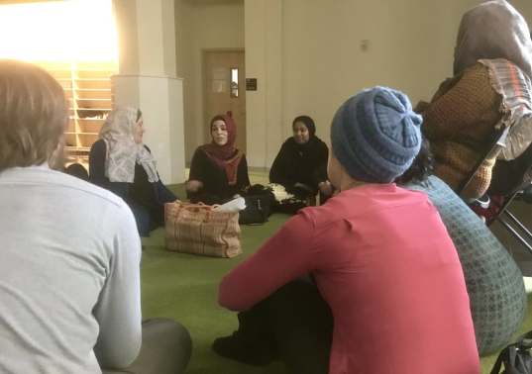
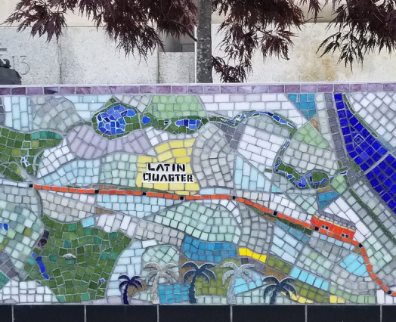
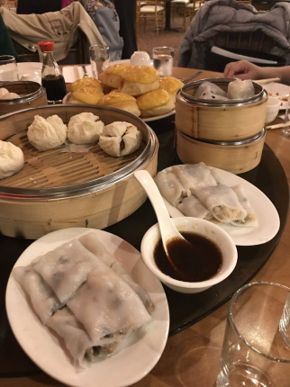
2nd Annual Center for Equity & Cultural Wealth Institute

Slide 10
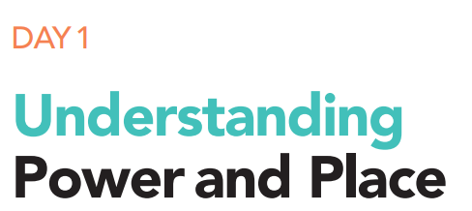
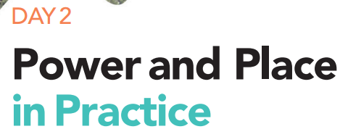
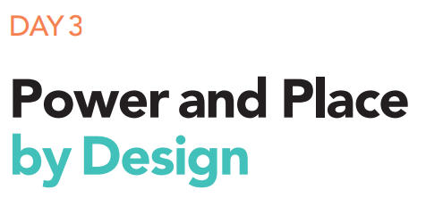
2nd Annual Center for Equity & Cultural Wealth Institute
Institute Follow-Up Activities
Summer 2019 Research, Curricular and Co-Curricular Integration Stipends
Fall 2019 Ongoing Design and Pilot
Creation of strategic plan (Washington Center)

Slide 11
Next Steps
Continued professional development and support for curricular/co-curricular integration
Increased faculty and staff engagement
Focus on Equity-Minded Practice
Renewed focus on assessment of student learning outcomes
3-year strategic plan for Center institutionalization
Shift from internal activities to external Institute
Integration of CECW principles into campus-wide programs, practices and policies

Slide 12
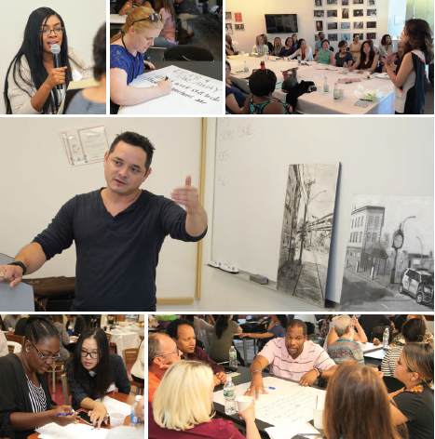
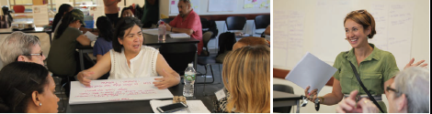
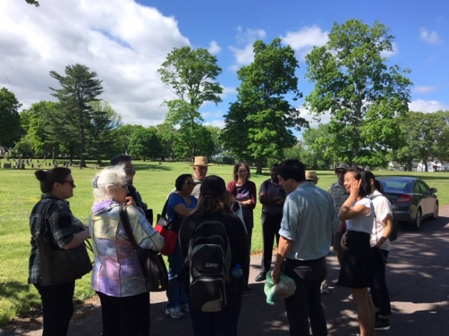
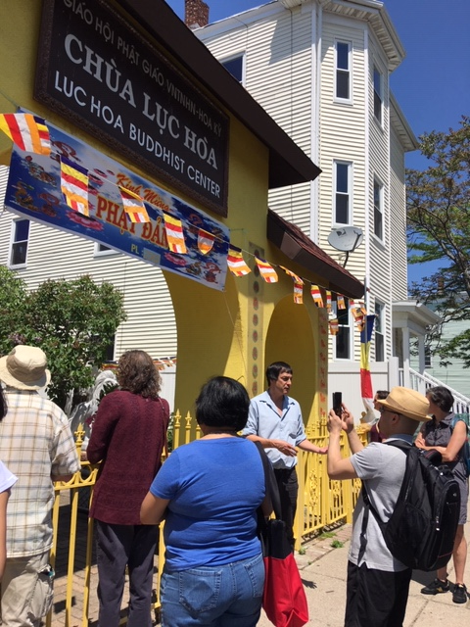
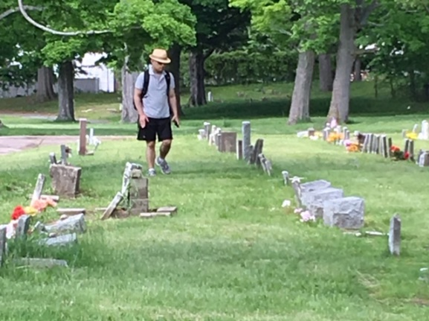
Questions & discussion

