Slide 1


Delaware State University AAC&U General Education and Assessment Action Plan
June 8, 2018
Salt Lake City, Utah

Slide 2
Specific Goals
Revise the general education program in order to condense its goals into a more cohesive program that fulfills both our land grant responsibility and our recognition of the importance of the liberal arts for a meaningful college education
Seek methods to engage students more actively in their learning so that they take greater responsibility for and engage in their collegiate career

Slide 3
Find linkages between the general education learning goals and those in the majors in order to reinforce and enhance foundational knowledge; essential skills; civic and global; applied, collaborative and integrated learning
Explore and implement more effective pedagogies both to enhance student learning and more accurately assess it for the purpose of inquiry and improvement
Seek methods to incorporate experiential learning into the general education goals, especially in the areas of student research and service learning

Slide 4
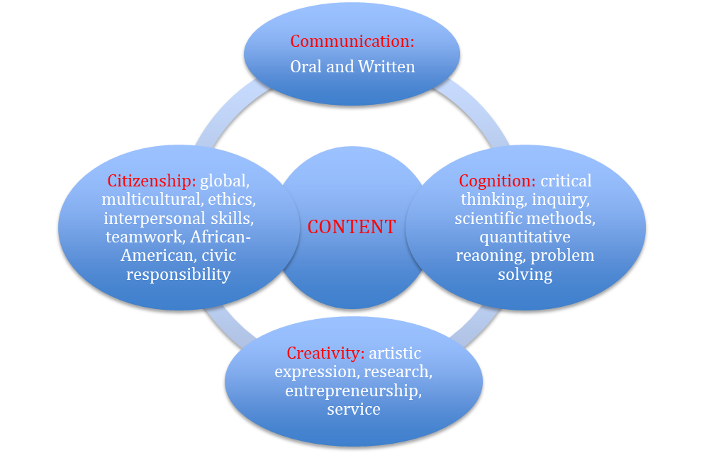
The Five Cs: Proposed Five Educational Constructs

Slide 5
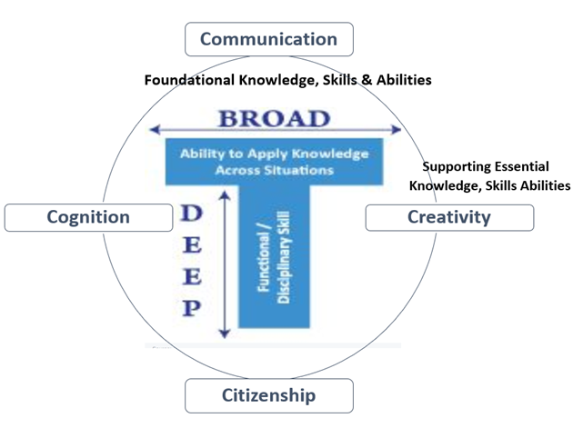
The DSU Student

Slide 6
Timeline for Completion
Summer 2018
Attend AAC&U Summer Institute and create action plan.
Work with administration to get support for action plan.
Gather resources for to inform and guide workgroups.
Identify workgroup membership and establish operational logistics.

Slide 7
High Impact Practices Working Groups
First-year Experience: core courses, advising, mentoring, establish relationships with faculty, e-portfolios, University Seminar goals
Experiential Learning through Research and Service Learning:
Global Learning and Study Abroad:
Communication/Writing Intensive Experiences:

Slide 8
Other Working Groups and/or Ideas for Consideration
General Education Goals and SLOs: MSCHE, VALUE rubrics, GEMS, Lumina, employer surveys and other models.
Assessment as Means of Inquiry: move from accountability to improvements through embedded assignments, professional development of faculty and staff to support assessment processes,
Faculty Professional Development: improved teaching through pedagogy, curriculum design and assessment
Integrated Learning for Transfer in General Education: implement e-portfolios, Signature Work, collaborative teaching, echoing, faculty partnerships between General Education and the majors

Slide 9
Fall 2018
Faculty Institute (August 24, 2018): Workgroup Introductions
Workgroup Stage #1: August-December 14, 2018
Create multiple workgroups for each area to include academics, student affairs, students and administrators as appropriate (2-3 groups of 5 people each) (70-120 people).
Initial workgroups meet to come to conclusions about improvement and opportunities (September-October).
Each of 8 workgroups (combine multiple workgroups) meet and develop recommendations for the University (November-December 14, 2018).

Slide 10
Spring 2019
Workgroup Stage #2: Condensed core group of stakeholders will create plan of action by March 31, 2019.
April-May 2019
Create process for curriculum and assessment review in the majors to be undertaken in fall 2019 with support.
Move new General Education plan and structure through Faculty Senate and the General Faculty.
Summer 2019
- Send DSU faculty teams to varied summer institutes for professional development.

Slide 11
Fall 2019
Programs review their curricula to look for linkages to GE goals and outcomes
Programs revise curricula to account for new GE program
“Assessment as Inquiry” explored in revised curricula by departments
Spring 2020
“Assessment as Inquiry” embedded in curriculum by departments
Programs move revisions through Faculty Senate
Present revised GE program to AAC&U General Education and Assessment Conference.
Summer 2020
- Send DSU faculty teams to varied summer institutes for professional development.
Fall 2020
1. Implement revised General Education program.

Slide 12
Support in the following areas will be required to accomplish these goals
Administration flexibility and support
Logistical support for process management
Expanded role and support from the Office of Institutional Effectiveness in areas of pedagogy, assessment, and DSU institutional data.
Incentives to faculty for participation in workgroups, conferences and other professional development opportunities.
Financial support for intensive teaching areas and service learning
Start up funds for faculty in Social Sciences and Humanities to expand undergraduate research and experiential learning.

Slide 13
Delaware State University Team
Alexa Silver, team leader
Andrew Lloyd
Phyllis Brooks Collins
Raymond Tutu
Ordner Taylor
Anthea Aikins

