Slide 1

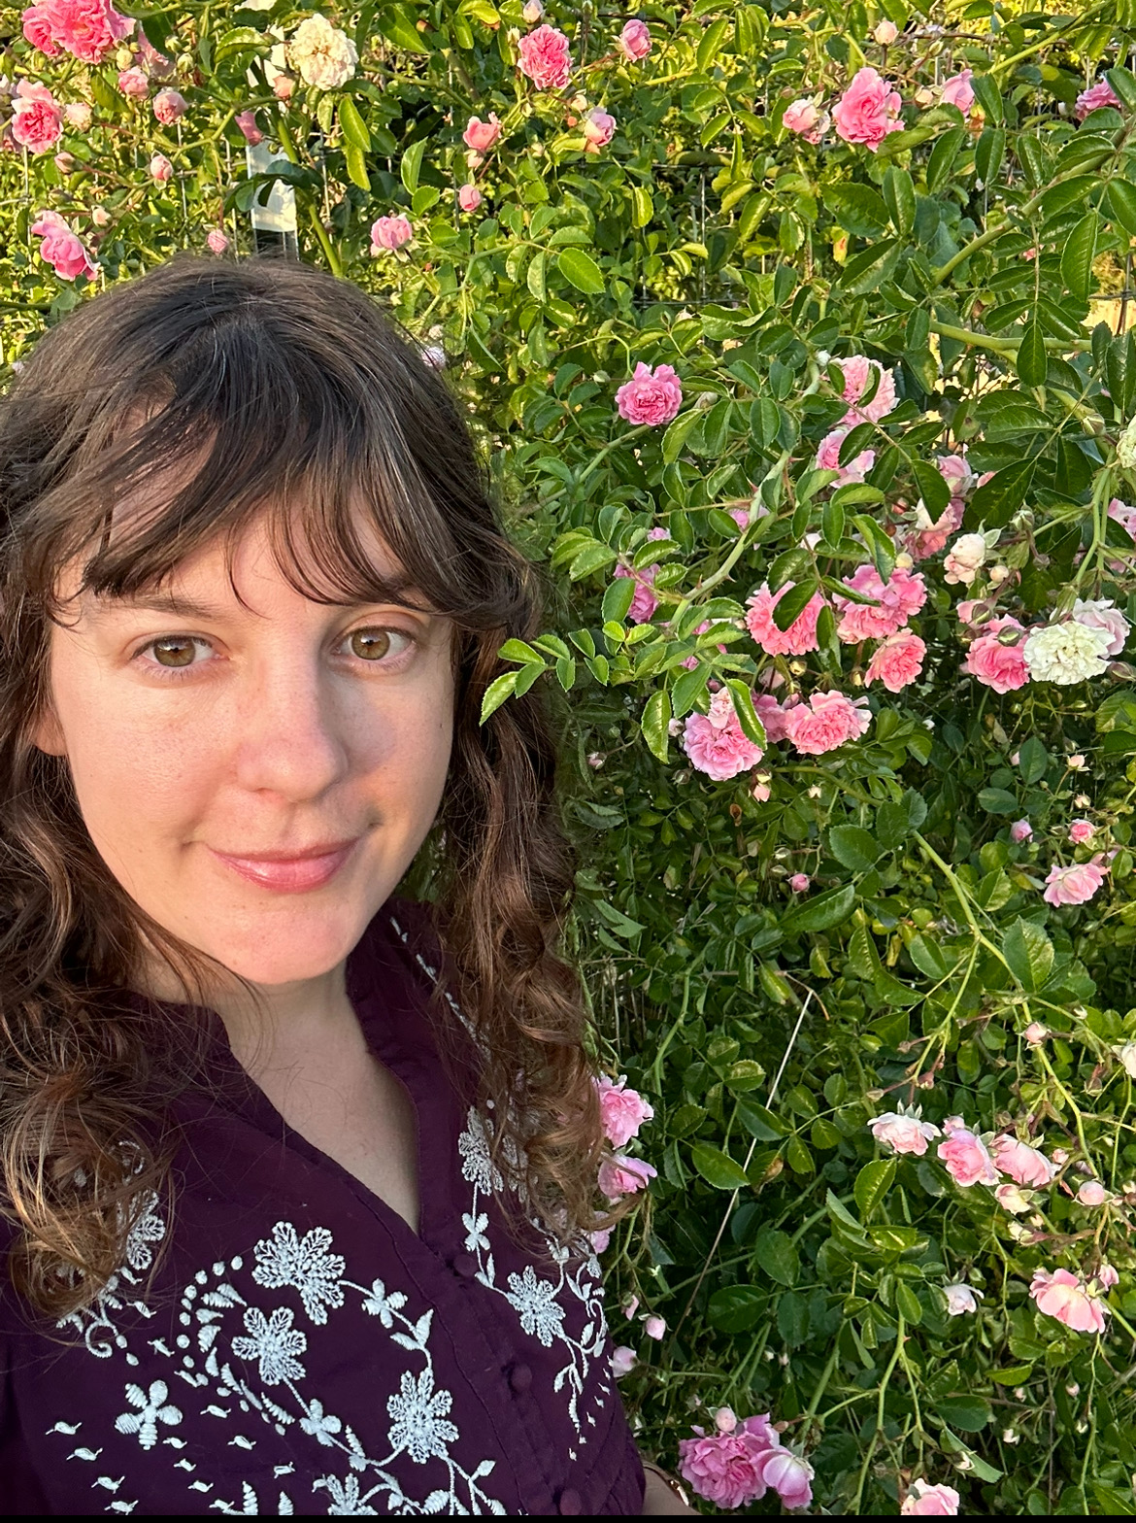

Medicinal Melodies
Ariel, Forest, Olive

Slide 2
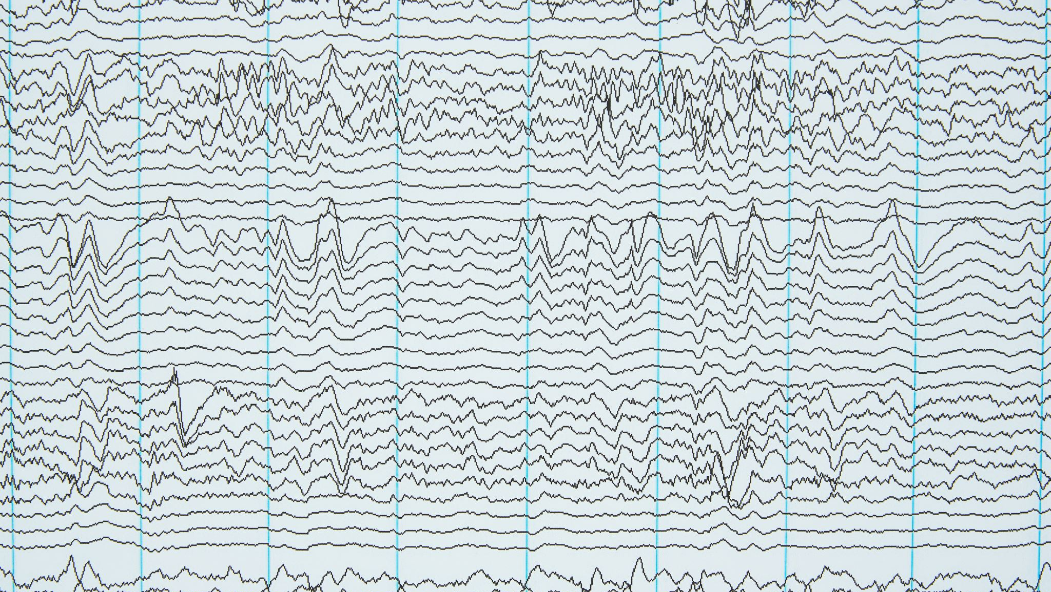
Pitches/Frequencies for Physical and Mental Healing

Slide 3
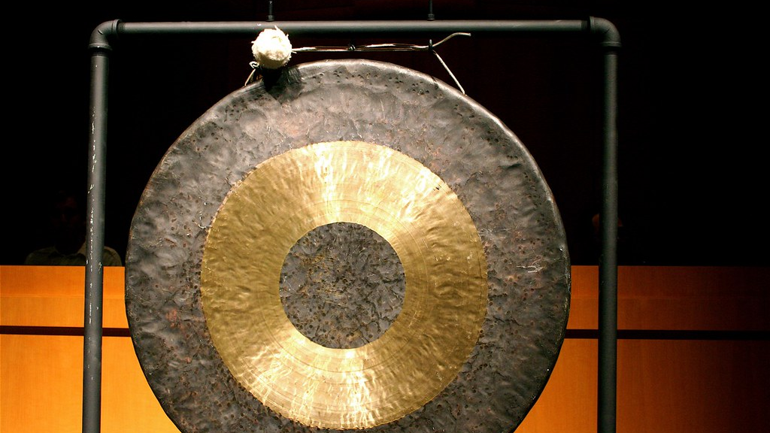
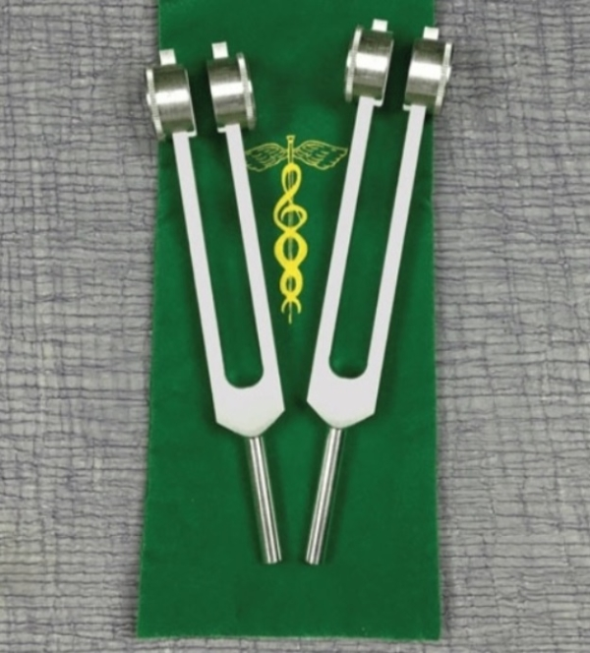
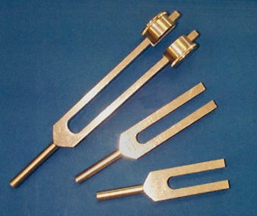
Some Tools for Healing
Tuning forks
  Weighted
  Unweighted
Gongs
Vocal Frequencies
Many others

Slide 4
Tuning Forks
Unweighted
Used for:
  Stress relief
  Relaxation
  Improving flow of qi
  Loud sound but low vibration strength
  Don't hold vibration for very long
Weighted
Used for:
  Sonopuncture
Quieter sound
Strong vibrations
Hold vibration for a while

Slide 5
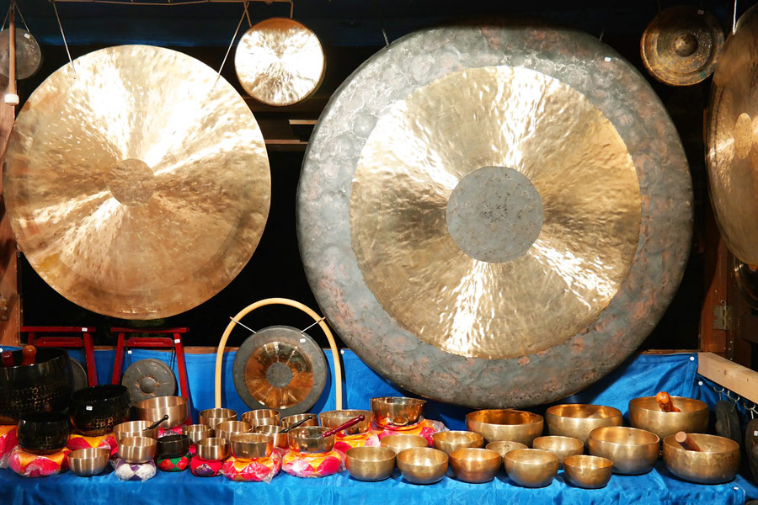
Gongs/Gong Baths
What is a gong?
Copper and tin disk hit with a mallet to create a vibrant sound
What is a gong bath?
Not actually a bath
Room is filled with the sound of gongs
  "bathing" yourself in the vibrations of the gongs
Benefits
Mental and physical relaxation
Stress reduction
Chronic pain relief
Improved immune function

Slide 6
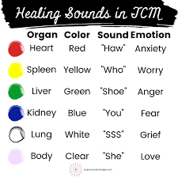
Vocal frequencies
Six Healing Sounds
Each sound associated with an organ, emotion, and color
  Heart = Anxiety
    "Haw"
  Spleen = Worry
    "Who"
  Liver = Anger
    "Shoe"
  Kidney = Fear
    "You"
  Lung = Grief
    "SSS"
  Body = Love
    "She"
How Does it Work?
Because you're making the noises, vibrations travel through your body
Benefits to Healing Sounds
Improved organ function
Reduced stress
Improving energy
Connecting with your body

Slide 7
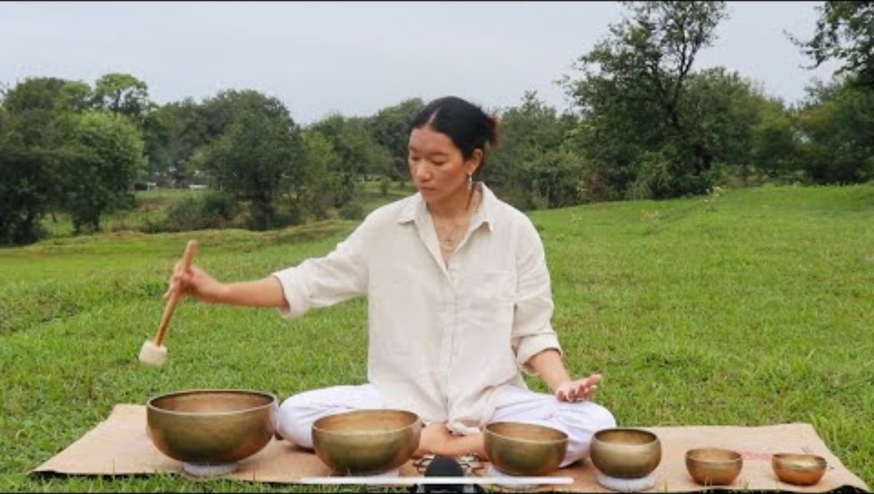
Singing Bowls- reduce stress, regulate heartbeat

Slide 8
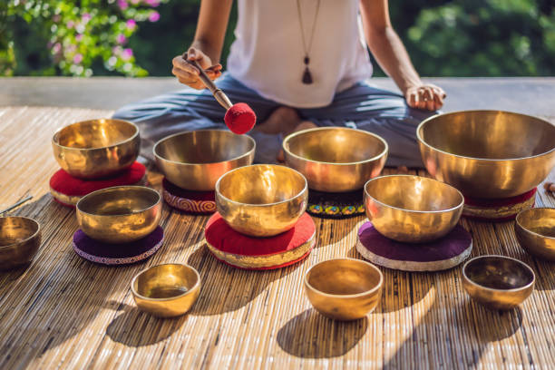
Transcendental
Transport the spirit,
Uplift the soul to a higher plane,
Unseen and essential
Release thought and self-image
Find truth in oneness of spirit

Slide 9
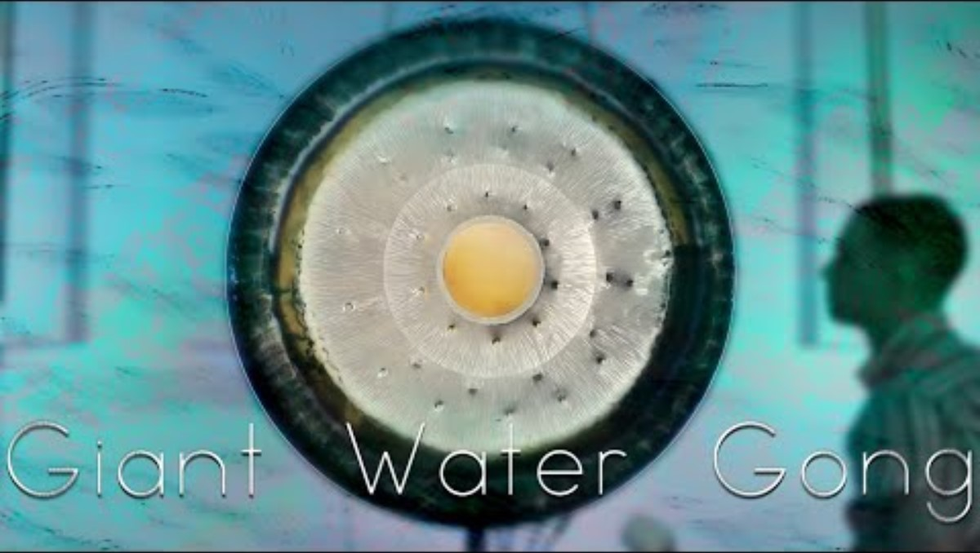

Slide 10
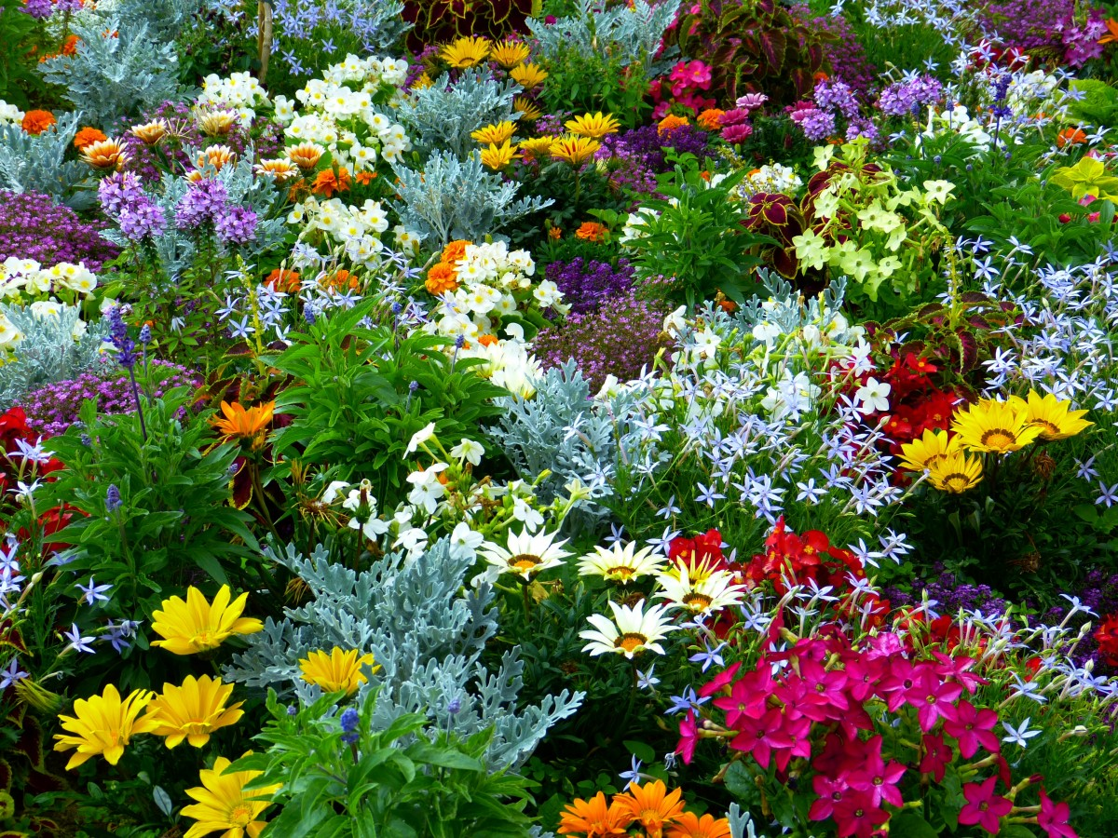
Forest – Nature Melodies
Plants can talk -
Expressing good health – differs in sounds from stressed plants
Requiring nutrients – emit sounds pops
Cuttings – differ in sound

Slide 11

Tress
Tress can sing -
Typically communicate through fungi
Not at a frequency we can hear
Emits a high frequency when stressed

Slide 12

Mother Nature's Melody
Forest Sounds:
https://youtu.be/xNN7iTA57jM?si=rZE2CVeIhItxVFGa
Sound of Rain on a Frozen Lake:
https://youtu.be/MP3WhIB9mQg?si=qGcS4ApJpivipRV9

Slide 13
References
Seetharaman, R., Avhad, S., & Rane, J. (2023). Exploring the Healing Power of Singing bowls: an Overview of Key Findings and Potential Benefits. EXPLORE, 20(1). https://doi.org/10.1016/j.explore.2023.07.007
‌https://lotsofzen.com/blogs/news/tuning-fork-healing-with-sound-therapy?srsltid=AfmBOopDN1Z8NK-ld6-bcwsC6d-p49NFG4dTPSgfkbydyzYaZhxzLM-O
https://www.soundhealing.gr/gong-bath-therapy-everything-you-need-to-know/
https://www.acupunctureinmichigan.com/the-six-healing-sounds-of-chinese-medicine/
https://www.pacificcollege.edu/news/blog/2022/04/12/the-6-healing-sounds-and-their-therapeutic-applications

