Slide 1
Wed. Feb. 25 – Physics Lecture #32
Faraday’s Law II
1. Lenz’s Law (fight the flux change)
2. Faraday’s Law (changing magnetic fields are the source of an electric field)
Office Hours:
Rachel Wed: noon to 1 or 1 – 2
Krishna Wed 1 – 3:30 (appointment), Thu: 3 – 4 (open)
Seth as usual
Wed. Mar. 4
All-Campus Mentoring Day (1 – 4) http://www.evergreen.edu/events/mentoringdays/
Academic Fair (4 – 6)

Slide 2
Example: Applying Lenz’s Law – Fight the Flux Change!
A solenoid is used to create a uniform magnetic field
that points into the page. A wire loop of area A is in
the magnetic field, as shown. For each of the following
cases, choose one of the following for the direction of
the induced current in the loop:
1. Clockwise
2. Counterclockwise
3. No induced current
4. Not enough info
x x x x x
x x x x x
x x x x x
x x x x x
a) The loop is moved to the left, staying in the B field.
b) The loop is crushed to smaller area.
c) The magnetic field is increased.
d) The magnetic field direction is reversed.

Slide 3
Applying Faraday’s Law for Changing Magnetic Field
A uniform magnetic field B is produced in a solenoid
of radius a, as shown. A loop is concentric with the
axis of the solenoid, and has radius b.
The current in the solenoid varies with time, so the
magnetic field in the solenoid also varies with time,
such that B(t) = B₀t, where is a B₀ constant.
a) What is the magnitude of the induced ε in the loop?
b) What is the source of this ε_{ind}?
c) What is the magnitude and direction of the induced electric field?
d) What is different if b < a?
e) If the loop were conducting, what direction would the induced current flow?
a
b

Slide 4
A conducting wire with resistance R shaped into an isosceles right triangle (base b, height h) enters a region of uniform magnetic field, as shown (B inside box, 0 outside box), moved at constant velocity v.
What is the direction of the current induced in the triangle as it enters the magnetic field?
What is the magnitude of the current induced in the triangle as it enters the magnetic field?
Challenge version (do on your own time):
What if the wire were shaped as a circle of radius a?
v
h
b

Slide 5
Faraday Generator Paradox?
A uniform magnetic field B points into the
page as shown.
A disk (radius a) made out of a conducting
material that lies in the plane of the page
is rotated clockwise at constant ω.
a) What can you say about the flux through the conducting disk?
b) What can you say about the change in flux through the disk?
c) What can you say about the ε induced in the disk?
x x x x x
x x x x x
x x x x x
x x x x x

Slide 6
A bar magnet is released above a circular loop of wire as shown, and falls through the loop. The loop is held fixed. Consider the following directions, as viewed when looking at the loop from above:
1. Clockwise 3. No current
2. Counterclockwise 4. Not enough information
What is the direction of any induced current in the wire loop, while the bar magnet is falling away from the loop from below?
N
S
N
What is the direction of any induced current in the wire loop, while the bar magnet is falling towards the loop from above?
N
S
N

Slide 7
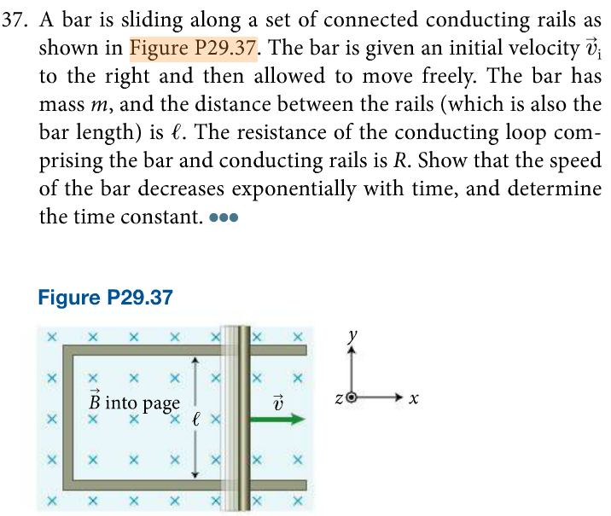
Find the velocity of the bar as a function of time.

Slide 8
