Slide 1
Mon. Feb. 23 – Physics Lecture #31
Magnetic Induction & Faraday’s Law I
1. Motional emf (conductor moving through magnetic field induces electric field)
2. Faraday’s Law (changing magnetic flux induces electric field)
3. Lenz’s Law (fight the flux change)
Office Hours:
Rachel Wed: noon to 1 or 1 – 2
Krishna Thu: 2 – 3
Seth as usual
Short Advising Conferences, by sign-up
Krishna Wed: 1 – 3:30
Wed. Mar. 4
All-Campus Mentoring Day (1 – 4) http://www.evergreen.edu/events/mentoringdays/
Academic Fair (4 – 6)

Slide 2
A uniform magnetic field B points into the page as shown. A short straight wire (length L) is moved to the right with speed v.
a) What direction is the magnetic force acting on the electrons in the wire?
b) What direction is the induced electric field in the wire?
x x x x x
x x x x x
x x x x x
x x x x x
L
v
1. Up
2. Down
3. Right
4. Left
5. Into page
6. Out of page
0. No direction/zero

Slide 3
A uniform magnetic field B points into the page
as shown. A short straight wire (length L) is moved
to the right with speed v.
What is the magnitude of the electric field in the wire,
in steady state?
What is the magnitude of the potential difference in
the wire?
What is the electric field if the wire is at a 30 degree angle instead of vertical?
x x x x x
x x x x x
x x x x x
x x x x x
L
v

Slide 4
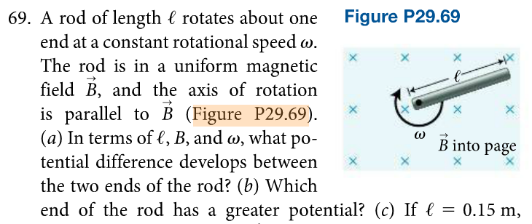

Slide 5
A uniform magnetic field B points into the page as shown. A piece of conducting wire is bent into a sideways “U” shape.
Another piece of short straight wire can slide along the “rails” of the U shape, and is moved to the right speed with speed v.
What is the direction of the induced current in the loop?
1. Clockwise
2. Counterclockwise
3. No induced current
4. Not enough information
x x x x x
x x x x x
x x x x x
x x x x x
x x x x x
x x x x x
x x x x x
x x x x x
v

Slide 6
x x x x x
x x x x x
x x x x x
x x x x x
Example: Applying Faraday’s Law for Changing Area
A uniform magnetic field points into the page
as shown. A piece of short straight wire can
slide along the “rails” of the U shape, and is
moved to the right speed with speed v.
The overall resistance is R.
Use the flux change rule to determine the magnitude of the induced ε.
Using Lenz’s Law, determine the direction of the induced current.
L
v
x

Slide 7
Faraday’s Law for Changing Angle:
A square loop of wire
with side length a is located in
a uniform magnetic field B
pointed in the +z direction. The
loop rotates about the x axis
with constant period T seconds,
or at f revolutions per second,
or at ω = 2πf = 2π/T radians/s.
The angle between area vector and magnetic field is given by
θ(t) = ωt = (2πf) t = (2π/T) t.
a) Determine the magnetic flux through the loop at t = 0 and T/4.
b) Determine the emf induced in the loop as a function of time and the peak emf induced in the coil. What is the coil’s orientation at peak emf?

Slide 8
